Slide 1
4.3
Looping over Strings
10/14/2022

Slide 2
Refresher: String Methods!
int length() | Returns the number of characters in a String object. | str.length()
int indexOf(String str) int indexOf(String str, int fromIndex) | Returns the index of the first occurrence of str [starting at fromIndex, if provided]. Returns -1 if not found. | str.indexOf("ing") str.indexOf("ch", 9)
String substring(int from, int to) String substring(int from) | Returns substring beginning at index from and ending at (to - 1) [or length()-1, if to isn’t provided]. | str.substring(7, 10) str.substring(3) str.substring(i, i+1)
char charAt(int index) | Returns the character in the string at index. | str.charAt(2)

Slide 3
String Transformations Using Loops
Many loops over strings are to transform a string into another string, e.g., remove spaces, reverse it. This can be approached in multiple ways. Here are two approaches:
Approach #1: Transform the same String variable repeatedly until you achieve the desired result.
s = "Let us remove all spaces" s ← "Letus remove all spaces" s ← "Letusremove all spaces" s ← "Letusremoveall spaces" s ← "Letusremoveallspaces"
(Remember, Java Strings are immutable, meaning they cannot be modified. When s changes, you aren't modifying the same String instance… you are repeatedly changing what the String reference variable s points to.)
Approach #2: Loop over the source String, leaving it unchanged, to build up a new result String.
s = "Let us remove all spaces" result ← "Let" result ← "Letus" result ← "Letusremove" result ← "Letusremoveall" result ← "Letusremoveallspaces"
Neither approach is always better. It depends on the problem you're solving. You may need to benchmark the code both ways to find what works better.

Slide 4
Manipulating Strings with while Loops

Slide 5

Example: Use a while loop to remove letters from a String
How can we use a while loop to remove all spaces from this String?

Slide 6
Fill in the code
public static String removeSpaces(String s) {
int i = s.indexOf(" ");
// while there is a " " in the string while (i >= 0) { ...
i = s.indexOf(" "); }
return s;
}

Slide 7
Fill in the code
Here's one way you can do it (there are more than one ways to complete this code! Can you think of another way?)
public static String removeSpaces(String s) { int i = s.indexOf(" ");
// while there is a " " in the string while (i >= 0) { // Remove the " " at index by concatenating // substring up to index and then rest of the string. s = s.substring(0, i) + s.substring(i+1);
i = s.indexOf(" ");
}
return s;
}

Slide 8
Try it yourself: Work on Exercise 4.3.6 Replace Letter in CodeHS
If you finish ahead of time, try Exercise 4.3.7

Slide 9
When to use while vs for with strings?
Looking for a certain character or substring?
Don’t know how many times the loop needs to run?
Want to visit every character (e.g. reversing a string, checking if palindrome)?
while
for

Slide 10
Manipulating Strings with for Loops

Slide 11
Iterating through a String with a for Loop
Note here that the for loop starts at 0 and use the string’s length() for the ending condition.
String s = "example";
// loop through the string from 0 to length
for (int i = 0; i < s.length(); i++) {
String ithLetter = s.substring(i,i+1);
// Process the string at that index
...
}

Slide 12
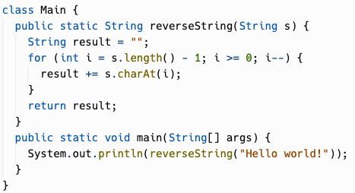
Reverse String Using for Loops
How else can we do this?

Slide 13
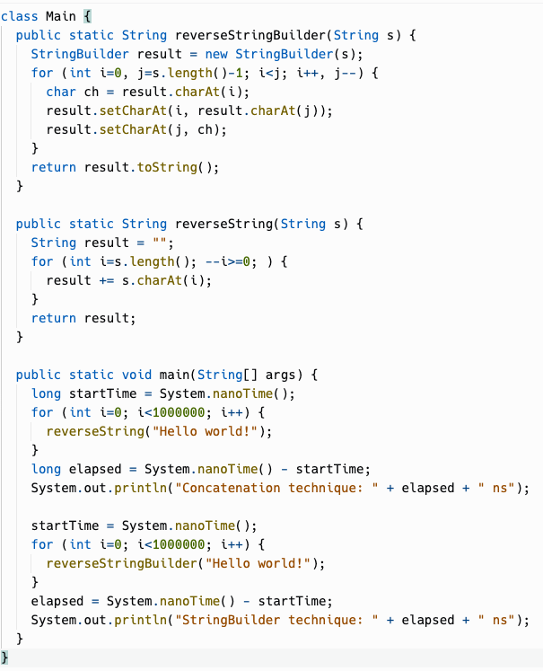

StringBuilder
Java actually has a mutable String class, StringBuilder, which can be much more performant for string loops.
It's not on the AP curriculum, so don't plan to use it on the exam.
With StringBuilder, reversing strings by swapping chars was 5X faster than concatenation! (StringBuilder actually has a built-in reverse method, too. String doesn't for some reason.) Still, StringBuilder is for building Strings… don't use it as a general replacement for String!

Slide 14
Try it yourself: Work on Exercise 4.3.8 Finding Palindromes in CodeHS

Slide 15
Practice!
Replit: Palindrome

